Slide 1
GDP Final Presentation
Team 05

Slide 2



Team members
Vinay Linginedi
Gopi Krishna Amara
Harika Naidu

Slide 3
Agenda
Introduction
Why PHP
How does it different than Node.js
Benefits from our tool chain choice
Deployment options
Gopi Krishna Amara

Slide 4
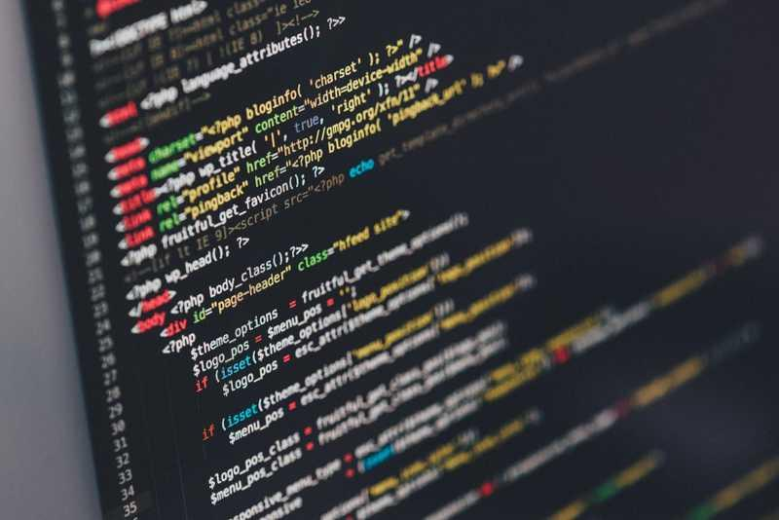
INTRODUCTION
PHP is acronym for “PHP, Hypertext Preprocessor”
PHP is widely-used, open source scripting language
PHP scripts are executed on server and the result is returned to the browser as plain HTML
PHP files contain text, HTML, CSS, Javascript, and PHP code
Gopi Krishna Amara

Slide 5
WHY PHP?
PHP runs effectively on server side.
PHP can interact with any client side scripting language and that gave so much space in terms of app development.
PHP takes less number of lines to code.
PHP supports wide range of databases.(MySQL,MySQLi,SQLite,PostgreSQL,Oracle(OCI8),Oracle,Microsoft SQL Server,Sybase,ODBC,mSQL,IBM DB2,Cloudspace,Apache Derby,Informix,Ovrimos SQL,Lotus,Notes,DB++,DBM,dBase,DBX,FrontBase,filePro,Ingres II,SESAM,Firebird/InterBase,Paradox File Access,MaxDB,PDO).
PHP is compatible with almost all servers used today (Apache, IIS, etc).
Supports more frameworks and CMS.
Gopi Krishna Amara

Slide 6
HOW DOES IT DIFFERENT THAN Node.js ?
PHP is a programming language. Node.js is not a programming language; it is rather an interpreter of JavaScript code.
PHP is not same anymore, it's completely rewritten and lot better from PHP7.
We can use event loops,callbacks, and non-blocking I/O with ReactPHP.
In order to code on Node.js, you have to understand callback functions and blockings.
Ease of use : there is always a hassle-free way to update functionality with PHP.
Cross-platform compatibility: PHP supports all the major OS. These are Windows, Linux, UNIX and MacOS. Thus, PHP websites can be integrated in nearly all the web servers on the Internet.
Gopi Krishna Amara

Slide 7
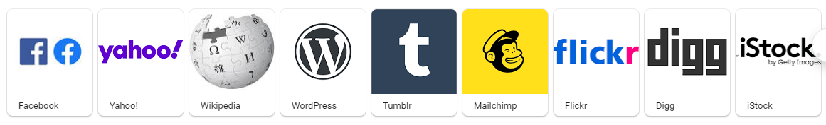
Famous PHP web application
Gopi Krishna Amara

Slide 8
HOW DOES IT DIFFERENT THAN Node.js
Context Switching
Node.js is written only in the javascript on both server side and client side. So there is no chance of switching between languages.
The Switch between different environments and language is possible in PHP because of the LAMP stack.
Harika Naidu
Notes:
LAMP Stack includes Mysql for database, PHP and Linux

Slide 9
HOW DOES IT DIFFERENT THAN Node.js
Modules
PHP uses the two model installing technologies.
PEAR
Composer
Node.js comes with a package management system called NPM (Node Package Manager).
Harika Naidu
Notes:
PEAR is framework and distributed system for reusable php components.
Composer is a tool for dependency management in PHP. It allows users to declare the libraries on which the project depends and it will manage (install/update) them for user.

Slide 10
HOW DOES IT DIFFERENT THAN Node.JS
Frameworks
PHP is a very popular server-side scripting language.
It also has many other frameworks like Cakephp, CodeIgniter, Laravel etc.,
Node.js uses a Express and stack MVC framework.
Harika Naidu
Notes:
Which helps in agile, robust and secure back-end development of web application.
MVC architecture is also included in the Laravel.

Slide 11
TOOLCHAIN CHOICE IN OUR APPLICATION
PHP - Client-side and Server-side javascript
Mysql - Is a SQL database program
XAMPP - It is a local web browser for testing and deployment process
Tortoise Git, HTML, CSS, JavaScript
PHP Mailer - Module for PHP to send emails
Harika Naidu

Slide 12
Benefits
Mysql:
Data security
High performance
Reduced total cost of ownership
Flexibility of open source
XAMPP:
You can start and stop the whole web server+database stack with one command.
XAMPP is portable so you can carry it around on a drive.
The security settings are strict by default, nobody but you will be able to access the web server.
PHP error reporting is enabled by default, which helps when debugging scripts
Harika Naidu

Slide 13
Benefits
Git:
Revert the code files back to their previous state
Recall and revert the entire project back to its previous state
Compare code changes over specific durations of time
Find who last modified a piece of code that might be causing an issue or a problem
Tortoise Git:
Easier to clone.
Easy to upload code.
Easy to pull/push code.
Easy to remove all untracked files from your local.
PHP mailer:
Inbuilt module for PHP send mails.
Harika Naidu

Slide 14
Deployment Options
cPanel:
cPanel is an online Linux-based web hosting control panel.
It provides a graphical interface and automation tools designed to simplify the process of hosting a web site to the website owner or the "end user".
Why we’ve chosen cPanel over heroku:
Faster and secure when the site get hits more than thousands of requests.
Easy to use.
cPanel empowers you to manage a web hosting account with maximum efficiency.
Vinay Linginedi

Slide 15
Click on the codeword below to use our codeword application….
Codeword
Vinay Linginedi

Slide 16
References
https://medium.com/@advanceidea/php-vs-node-js-which-one-is-better-for-you-1c323b924982
https://belitsoft.com/php-development-services/php7-vs-nodejs
https://www.websoptimization.com/blog/what-is-the-difference-between-php-and-node-js/
https://www.geeksforgeeks.org/php-vs-node-js/
Vinay Linginedi

Slide 17


